Slide 1
Theme & Learning intention:
Lockdown
Be able to natural discuss the current global situation online

Slide 2

Today we are going to:
Discuss the current global situation
Look at a text conversation to learn key vocabulary
Examine common omissions in online chats
Practise what we’ve learnt
So that you can:
Naturally discuss the current global situation online

Slide 3

Discussion:
How are you doing?
What’s the current situation in your country?
How have the government responded?
What do you think of their response?
How has your life changed in the past few weeks?

Slide 4
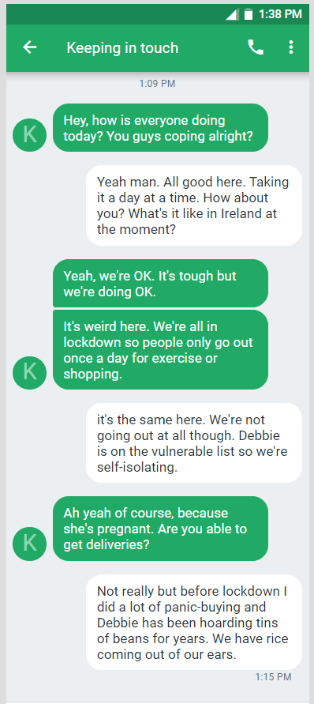
Read this chat. How similar is it to your experience?
Lexical Chain:
Conversations will often have a chain of words on the same topic going through them.
How many words/phrases can you find related to the current global situation?

Slide 5
Lexical Chain:
Language in Isolation
To be in lockdown
To be on the vulnerable list
To be self-isolating
To get deliveries
To do (a lot of) panic-buying
To hoard
Do you use similar words in your language?
Do you know their meaning? Can you guess it from the context?

Slide 6
Lexical Chain:
Language in Isolation
To be in lockdown
To be on the vulnerable list
To be self-isolating
To get deliveries
To do (a lot of) panic-buying
To hoard
Think back to your discussion at the beginning of the lesson. Can you use this vocabulary to describe the current situation in your country?
Definitions:
Match the language to the meanings below
The country is shut down and you cannot move around freely
To be more likely to struggle with Covid 19 because of another condition
To shop online and receive the food by truck to your house.
To buy more than what you need because you are worried there will not be enough
To store large quantities of something / more than you would need in your day to day life.
To choose to stay at home and avoid all contact with others

Slide 7

Checking in:
Look at the chat again and discuss the following questions:
How do they ask the question “how are you?”?
Why do they choose to ask it this way?
How would you say this in your language? Has it changed in a similar way to English?
Look at some of your online chats. How have you asked “how are you?” recently?
Was it the most appropriate way?
Notes:
In recent times, you will find a lot more people asking the “how are you coping?” question. “How are you” is almost meaningless because this is a difficult time for us all. It’s almost moved to mean “I know it’s awful but are you surviving? What are you doing to do so?”. It’s very much a way of checking in.

Slide 8

Online chatting:
Look at the underlined sentences:
What is missing?
Is this ok? Is this wrong?
Can you find any other sentences in the text that would be OK if you removed the auxiliary verb or subject?
Notes:
We tend to omit subjects in online chatting as it mirrors speech more than writing. We do the same with auxiliaries, especially in questions.

Slide 9

Vocabulary Grab:
It’s always nice to find new language chunks and try to use them in the same context. When you read a text, check for something nice you’d like to steal and use.
Can you find any pieces of English you’d like to steal and use?

Slide 10
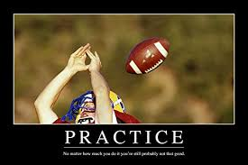
Discussion:
How are you doing?
What’s the current situation in your country?
How have the government responded?
What do you think of their response?
How has your life changed in the past few weeks?
Practice:
Contact someone in the class and carry out an online chat (e.g. WhatsApp / Teams / SMS) using one of the discussion question above.
Take a screenshot of your chat when it’s finished and check:
  Did you check in with each other?
  Did you use the language from the lesson?
  Did you omit any subjects and auxiliaries effectively?
3) Send it to your teacher for feedback.
Notes:
This could be done in breakout rooms or the lesson could be stopped and rejoined at a specific time. It could also be set as a post-lesson task.

Slide 11
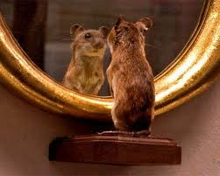
Reflection:
Let’s take a second and look backwards.
Discussion:
What have you taken from today’s lesson?
What can you use in your real life?
What were the steps we went through when we looked at the text?
Notes:
Steps:
Discuss the topic
Read the text to compare with your experience
Identify lexical chain and check understanding
Look for natural omission
Find some new pieces of English to steal
Discuss the topic again with new language.
Reflect on use of new language / skills

Slide 12
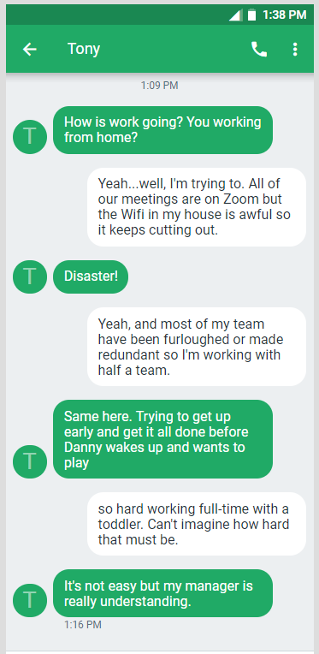
What’s the lexical chain in this text? What language can you find that you can steal?
Are there any examples of omission in this text?

