Slide 1



Textploitation
Exploiting tiny texts in the classroom
By
Mark Heffernan & David Byrne
m.heffernan@qmul.ac.uk & davidbyrne@ecenglish.com
textploitationtefl.com
(slides are available here)

Slide 2
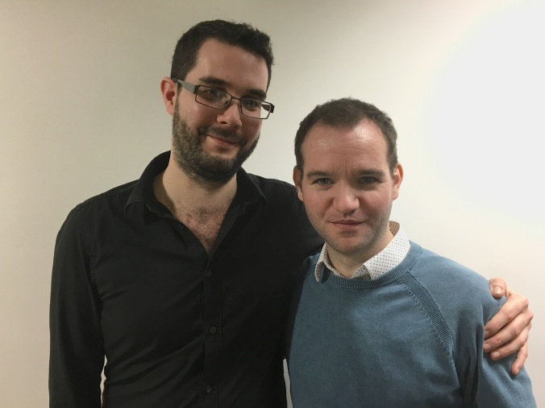
What kinds of texts do you currently use in your lessons?
What do you do with them?

Slide 3

What do we mean by a tiny text?
Tiny Texts:
A (text)message, note, quote, signage, ads, online comments, short reviews, horoscopes, voicemails, announcements, tweet, meme, GIF, or even snippets.
But why?
Little & often has a compound effect.
It mirrors real world reading practices.
It allows study to happen anytime and anywhere.

Slide 4
When should you introduce them?
Notes:
Topical lessons: Tweets do you agree.
Grammar points: text message
Topic: quote
Writing lesson: text message
Tiny Text Thursday?

Slide 5
What can you do with them?

Slide 6
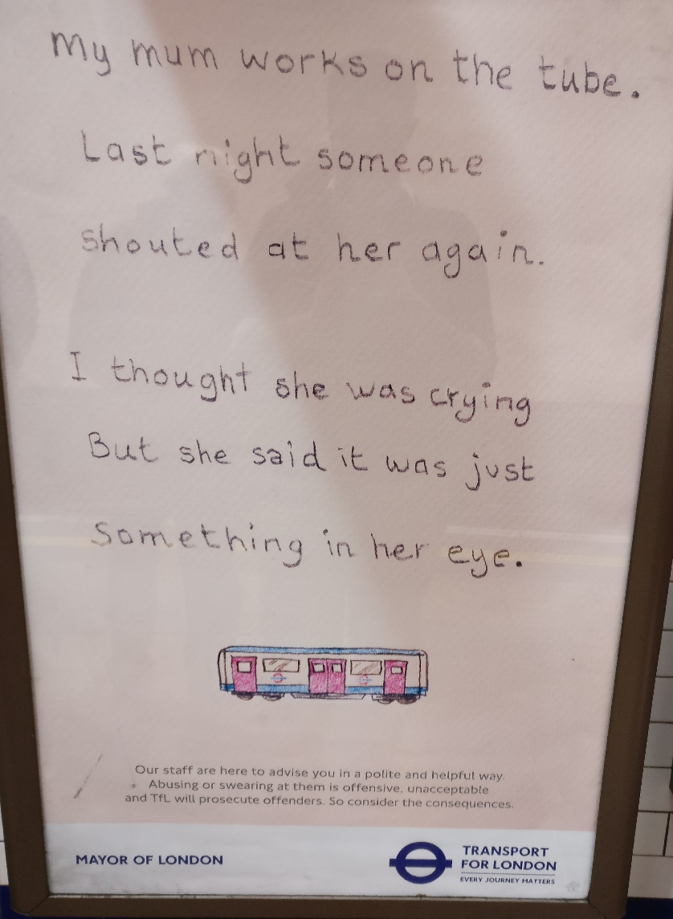
Why: Ask what tenses can be found, why the speaker/writer has chosen these.
Rewriting: Find the reported speech and rewrite it in direct speech.
Cohesion: What does “it” refer to?
Who is the speaker/writer?
What is the story behind the comment?
What is the aim of the ad? Is it effective?

Slide 7
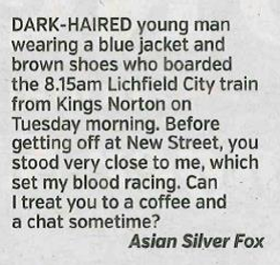
Cohesion: How does the writer write concisely?
  Underline examples of –ing. Are they the same/different?
  What examples of relative clauses can you find?
  Complex noun phrases
Tone/Register: What tone does it strike? How does it do so?
What can you tell about the person from this message?
Would this type of advert be effective in your country?

Slide 8
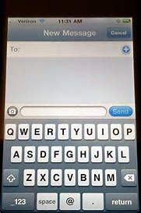
Written-Spoken English / Register:
Is it polite?
What words are omitted from this message? What effect on register does it have?
Would this be appropriate for speech?
Nice chunks of language:
- Can anything here be taken and repurposed?
Gonna pop to the shop. Need anything?
What is the relationship between the sender and receiver? How do you know?

Slide 9
Let’s take stock: what are we saying / not saying?
We are not saying:
You shouldn’t use larger texts.
You should only use tiny texts.
We are saying:
Using tiny texts allows for a variety of texts over a shorter period
Little and often can grow good habits
Students don’t always want / have time to read long texts outside class.
We are bombarded by tiny texts in the real world…lessons should mirror this.
This is how people communicate. Are we equipping our students to do so?
Asking questions of language, register & motivation in class can lead to students doing the same outside.

Slide 10
What are we saying you should look at?
Referencing (e.g. pronouns)
Are there any nice chunks that can be repurposed?
Can it be rewritten? Register?
Ask why?
Are there similar language points with different uses?
Is there any interesting punctuation?
What do we know about the writer?
Phones out.
Find a tiny text.
What could you do with it?
Share ideas with your partner
Are any words omitted? Why?
How is it organised? (writing)
Is it written English or written spoken English? What does it tell us about pronunciation?

Slide 11
Reflection:
At the beginning of the talk we asked you what texts you currently use.
Are there any ideas or activities you could now add to that list?

Slide 12

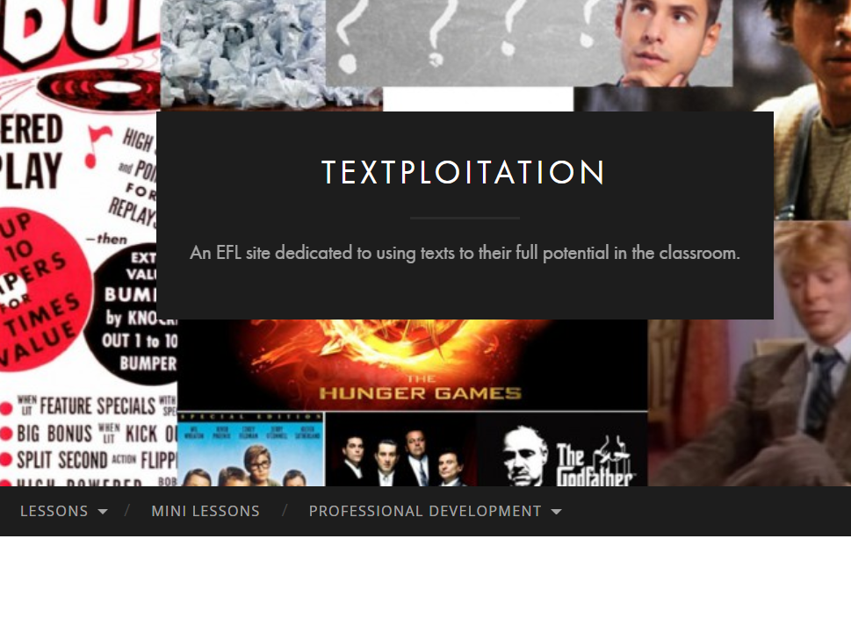
Mark Heffernan & David Byrne
m.heffernan@qmul.ac.uk & davidbyrne@ecenglish.com
textploitationtefl.com
(slides will be available here)

