Slide 1

Theme & Learning intention:
How would these skills be useful in your real life?
Events
Be able to describe a future event.

Slide 2

Today we are going to:
Look at participle clauses and “will” forms
Learn to analyse grammar in context
Write email invites to an event
Display and give feedback as a class
So that you can:
Write an engaging invite to an event

Slide 3

Discussion:
What was the last event you went to? What was it like?
Have you ever helped to organise an event?
How do you normally invite people to an event?

Slide 4
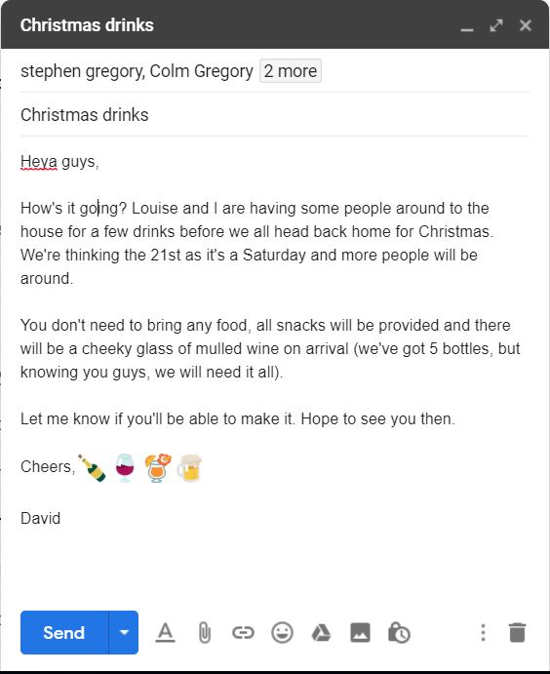

Grammar Grab:
Find an example of the following in the email:
Present continuous for the future.
Present simple for the future.
Present continuous for the present.
For each of them, discuss why the writer chose to use these tenses.

Slide 5
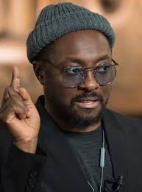
What’s the most common use of future in this email?
Why do you think they are using it so much?
Why not “be going to”?

Slide 6
What tense is this? Why is it here?
Future Passive:
Form: _____ + be + _____ ______________
Is often used to describe _________ catered for at an event.
What else might be catered for at an event?
Services / Will / Past Participle

Slide 7
Now, think about this language point.
What is the form?
Why is it used?
What does it mean?

Slide 8
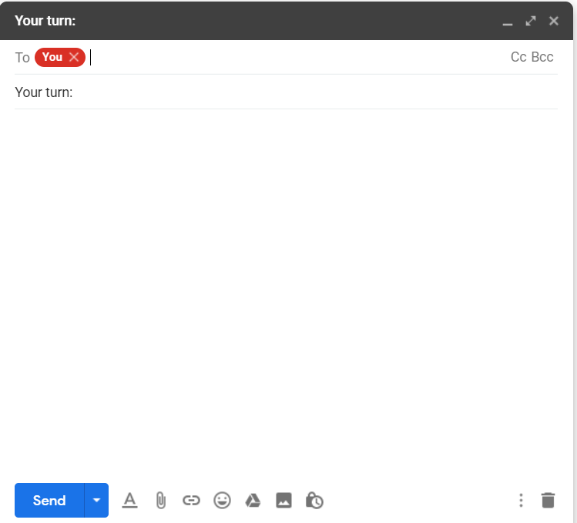
You’re going to write an email to your friends, inviting them to an event. Spend 2 minutes thinking about the event and then consider the grammar you will use.
Remember, successfully describing an event means:
Using present continuous to describe the arranged future event.
Using “will” to describe the features of the event and make predictions about it.
Using future passive to describe services that are catered for.
You could also consider including:
Present continuous to explain what “you’re thinking of” doing at the event.
Present participle clauses to describe what you will need because you know what your guests are like (“knowing you guys”)

Slide 9
Remember, successfully describing an event means:
Using present continuous to describe the arranged future event.
Using “will” to describe the features of the event and make predictions about it.
Using future passive to describe services that are catered for.
You could also consider including:
Present continuous to explain what “you’re thinking of” doing at the event.
Present participle clauses to describe what you will need because you know what your guests are like (“knowing you guys”)
Check your email…how did you do?

Slide 10
What have you taken from the lesson?
What will be useful in your life?
Today we:
Looked at participle clauses and “will” forms
Learnt to analyse grammar in context
Wrote email invites to an event
So that you can:
Write an engaging invite to an event

